Slide 1
BLOOD BUCKET
A bucket of Blood Doners

Slide 2
Submitted By
Supervised By
Name | ID
MD. Nahid Hasan | 16172103382
Rashedul Islam | 16172103183
Hafiz Al Foisal | 16172103382
Nahid Anwar
Lecturer
Department of CSE
Bangladesh University of Business and Technology

Slide 3


Objective Of Blood Bucket
Connect
Blood Donors
Patient

Slide 4
Tools Used
Visual Studio 2017
Bunifu UI
Microsoft Access
Adobe Illustrator
Adobe XD.
Adobe Premiere Pro

Slide 5
Let’s see the User Interface and the Features of Blood Bucket

Slide 6
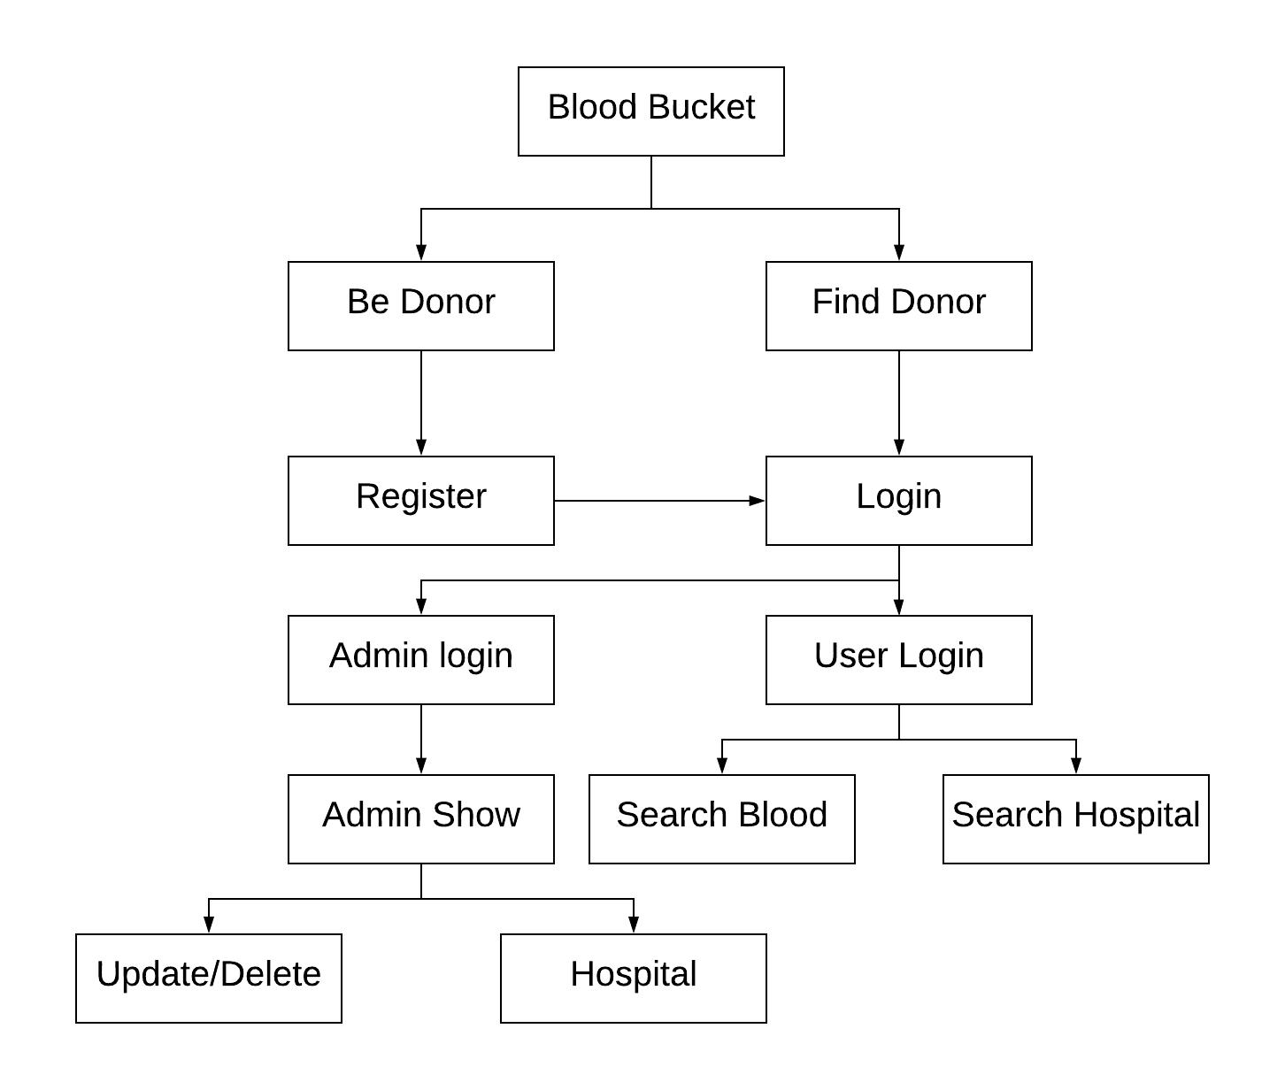
Flow Chart of System

Slide 7

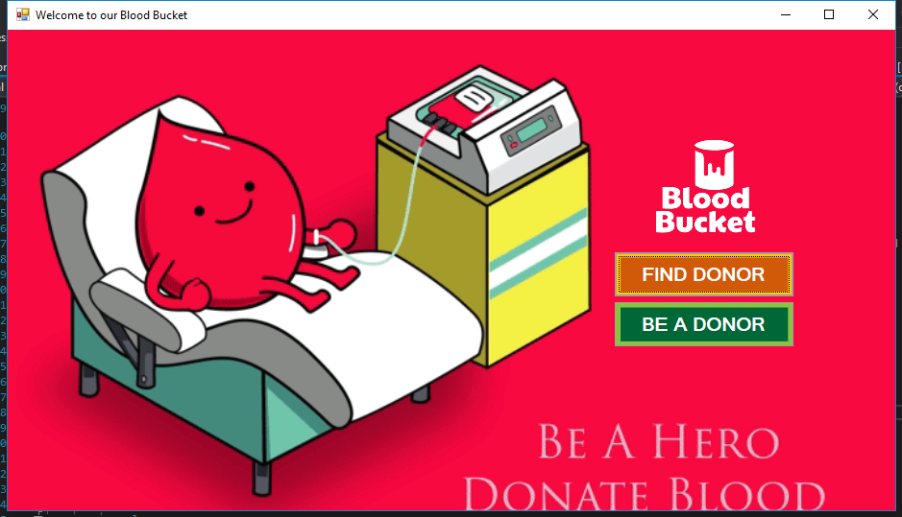
Welcome to our Blood Bucket
Here user can chose from two option. 1) Find Donor 2) Be a Donor

Slide 8
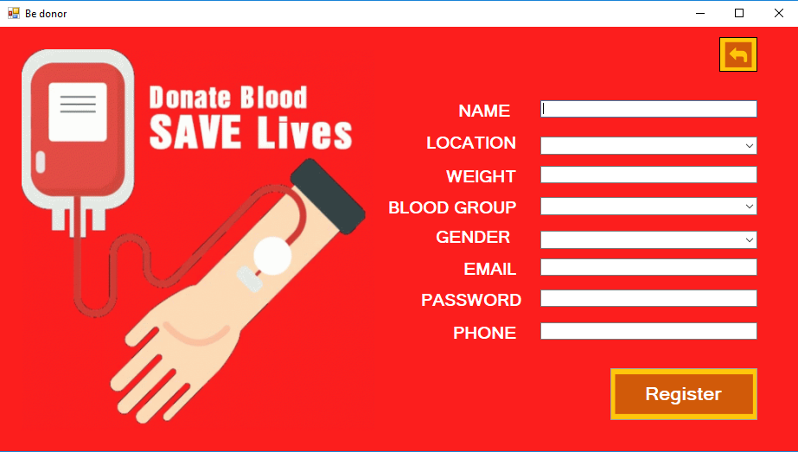

Be a Donor
Here user can register him/herself to become a donor

Slide 9
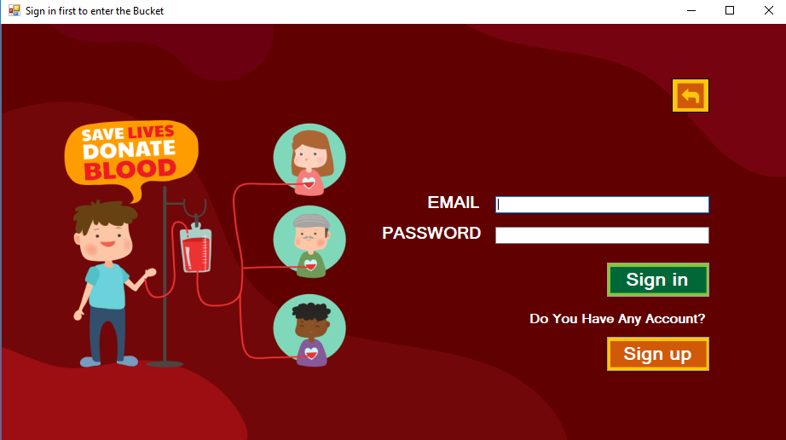
User Sign in
To find donor user has to sign in first to avoid any misuse of this system.

Slide 10
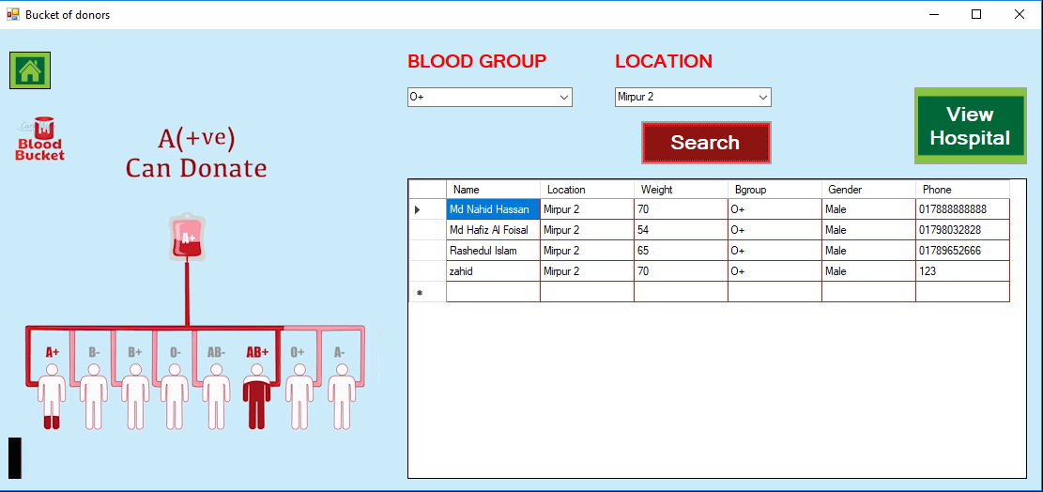

Find Donor
To find donor user has to select the blood type and the location.

Slide 11
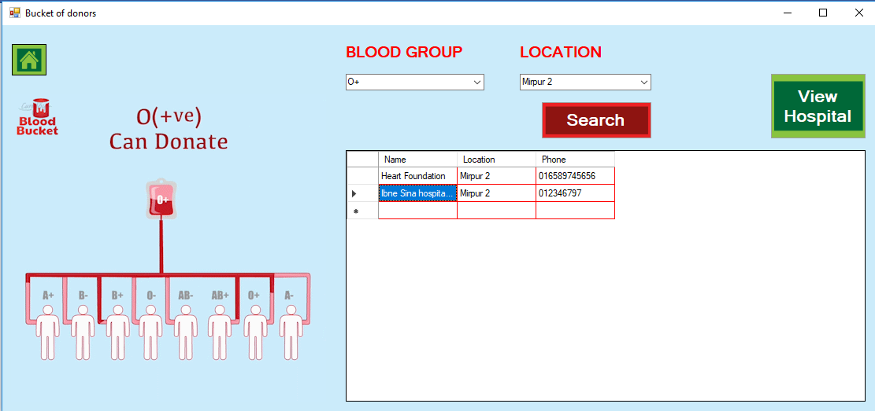
Find Donor
To find donor user has to select the blood type and the location.

Slide 12
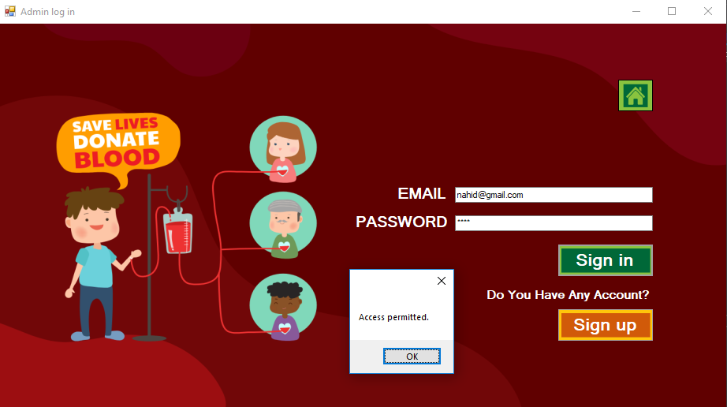
Admin Sign in
Only admin can access the back-end part and database of the system.

Slide 13
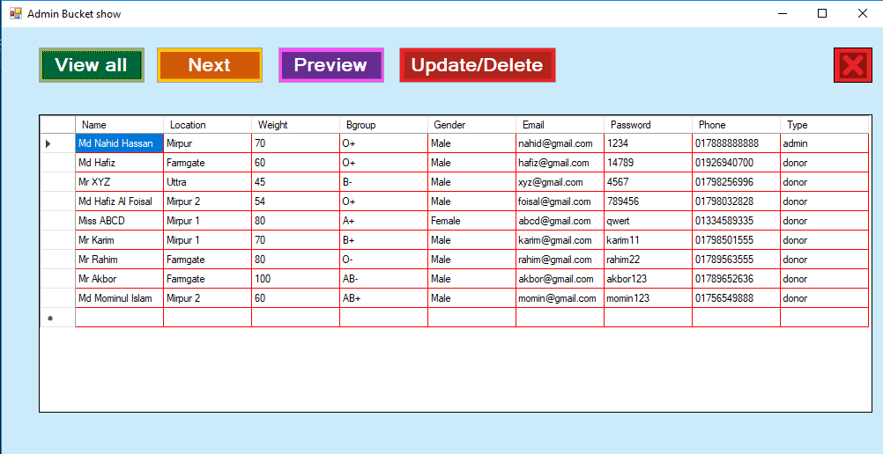
Database
Here admin can view all the information in the system database.

Slide 14
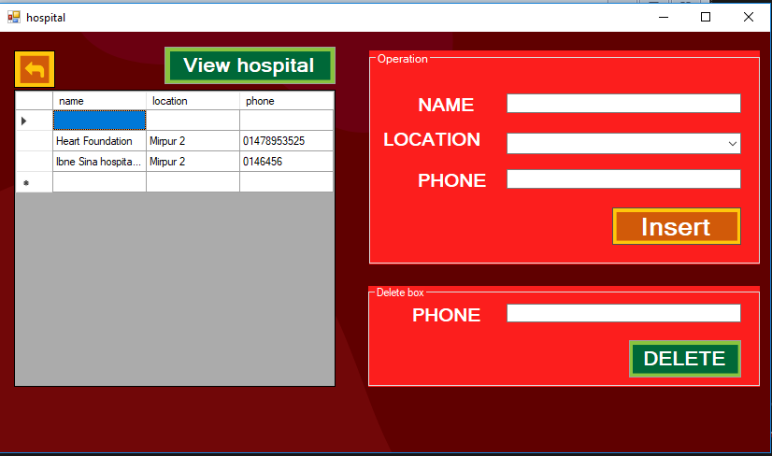
Update / delete
Here admin can search by phone number and chose to update or delete the information.

Slide 15
Let’s Learn More About Blood Bucket

Slide 16
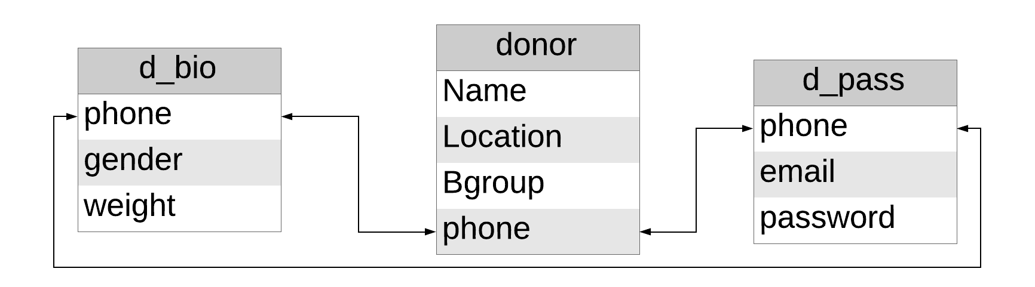
Entity Relationship Diagram

Slide 17
System Requirement (Hardware)
CPU
1.7 GHz Pentium IV
RAM
512 MB
Memory
1 GB

Slide 18
System Requirement (Software)
OS
Windows 7
MS Office
MS Access 2010

Slide 19
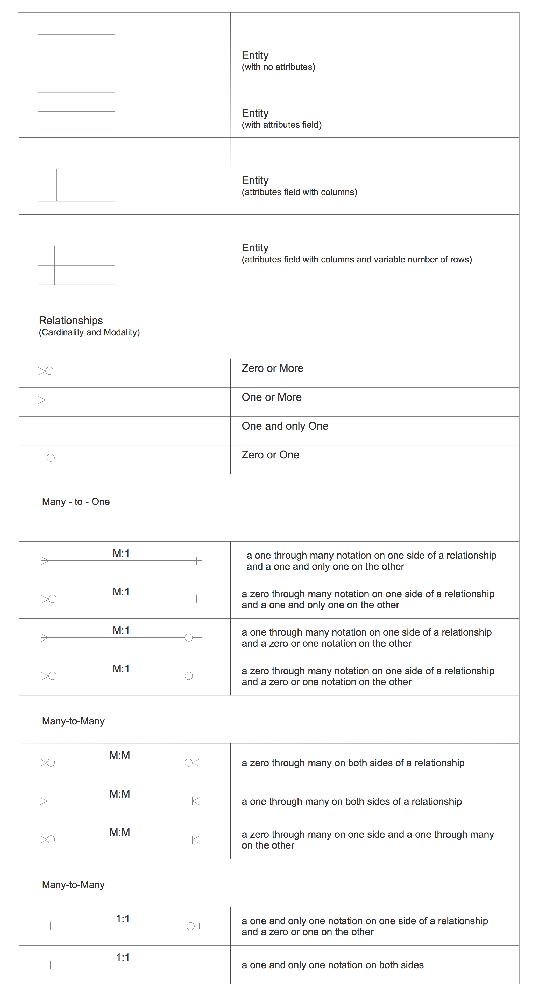

Slide 21
Why Blood Bucket?
There are a lots of blood donation organization/ services around our country. One or two organization cant fulfill the demand of this over populated country. As around 600 thousand units of blood were collected under public and private sectors. Blood bucket is just a helping hand to this blood donation community for better word.

Slide 22
Limitations
Database is not heavy enough ( lack of data )
Search can’t be done by all cities
Can’t control the blood taken by the user
Not online
No real-time information about the user or donor

Slide 23
Future of Blood Bucket
Enrich database
Available search for all cities
Control the blood transaction between user & patient
Online
Real-time information about the user or donor

Slide 24
What we have Learned.
Basic about C# language
Interface of Visual Studio
Design elements in Visual Studio
How to Analyze a system
Solving new problems
Team work and management

Slide 25
Let’s Have a Look on Code

Slide 26
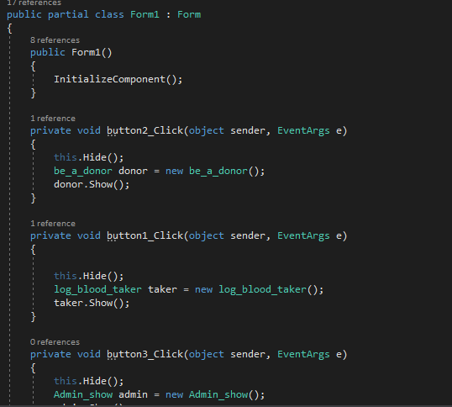
Welcome to our Blood Bucket
This part of the code contains the code to connect / redirecting form one form to another through button

Slide 27
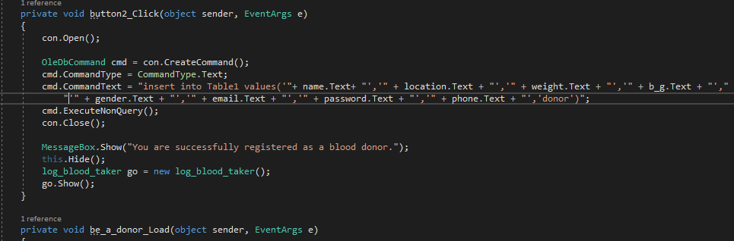
Be a Donor (Registration)
Here the data which are entered in the form by the user is inserted to the database.

Slide 28
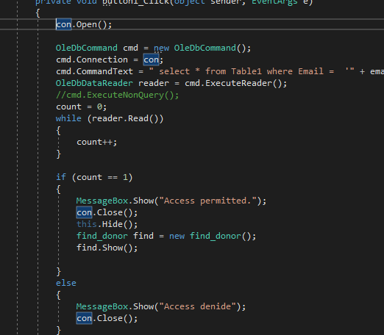
User Log in
This code confirms the log in process of user.

Slide 29
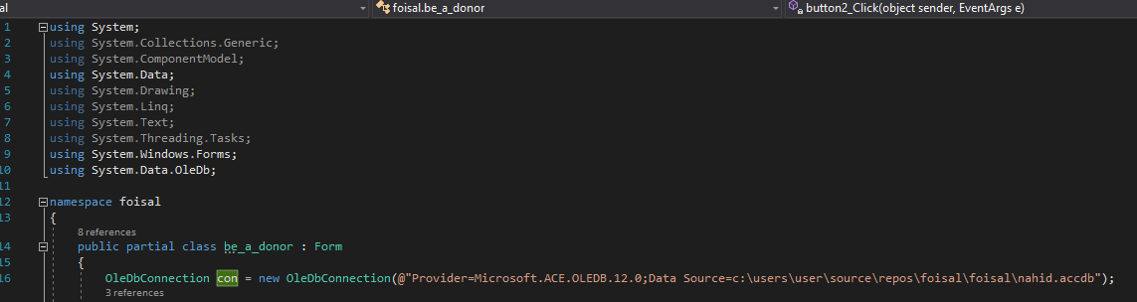
Be a Donor
This part of the code Connects the database to the system

Slide 30
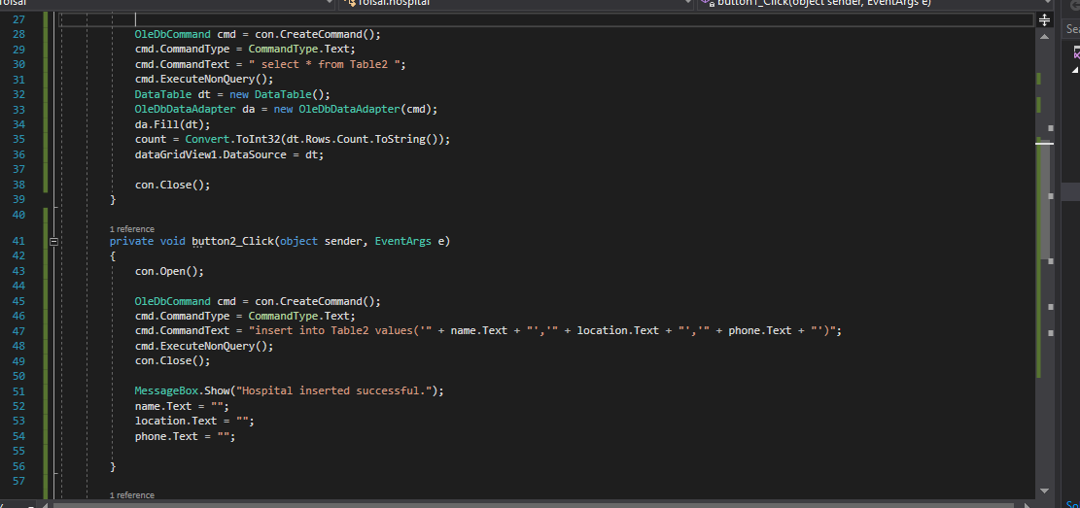
Hospital
Code to search hospitals by location

Slide 31
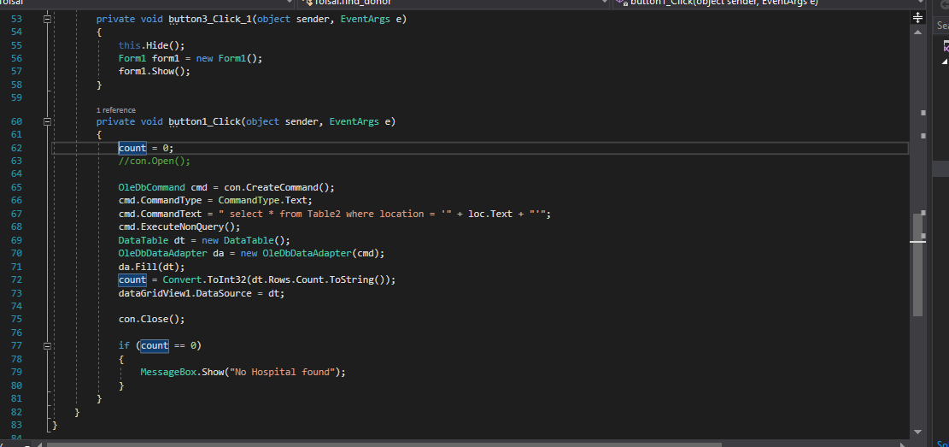
Hospital
Code to show hospitals

Slide 32
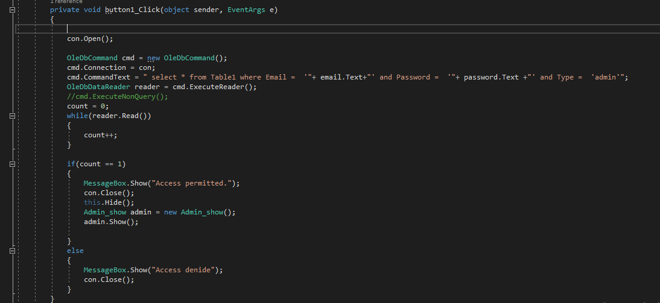
Admin Sign in
When the admin wants to enter the system the email and the password will be checked by this part of code

Slide 33
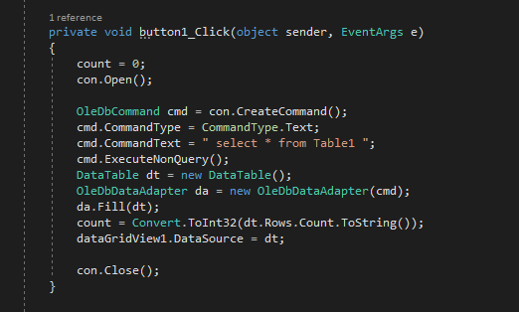
Database
This code allows the admin to see the entire data of the database

Slide 34
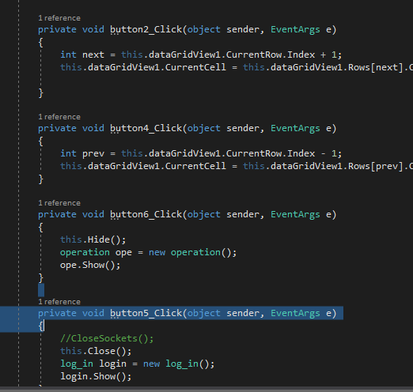
Next, Previous, Log Out
This part of the code allows admin to select next, previous data and also logout.

Slide 35
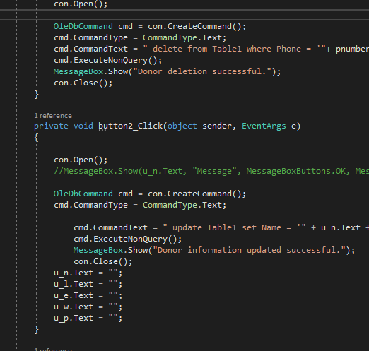
Update / Delete
To update or delete data from the database by the admin this code is executed.

Slide 36
There is no great joy than saving a soul.

Slide 37
Thank you !

